Slide 1

Panic At The Desktop Project 1-
Jack Harvey, Svitlana nAZARcHUK , Adib Khan, Shawn Cavalieri

Slide 2
mETHOD
We came into the analysis with the following hypothesis:
awggadfhadfaeht
To test this, our goal was to determine the relationship between the following 4 variables:
Civilian Labor Force (CLF)
Birth Rate
Unemployment Rate
Median Home Price
We found
AHAFHAS
G

Slide 3
Tech Requirements
Network
Satellite
Link

Slide 4

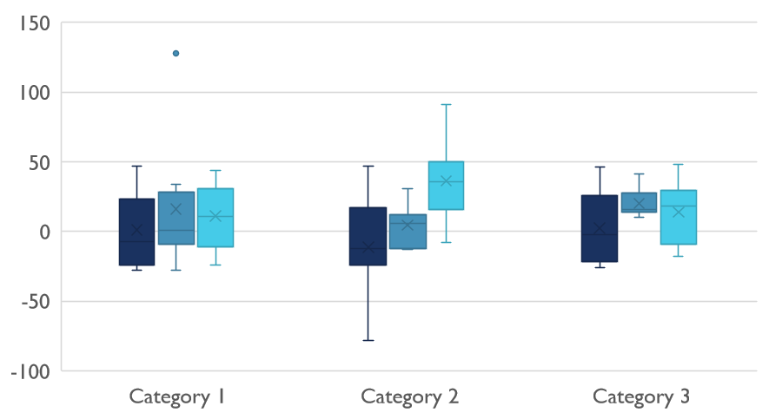
Competitive Landscape

Slide 5

Digital Communications
Cloud
Local
Hybrid

Slide 6

Thank You
someone@example.com

